Slide 1
AVOIDING BIAS
IN MACHINE
LEARNING ALGORITHMS
Karen Gibson

Slide 2
Overview
Algorithms are not always scientific fact!
Often they are:
decisions made by a humans and embedded into code
…and this means that they could contain:
the conscious or unconscious bias of the person who made the algorithm
the biases of the historical data that was used to help the person create the algorithm

Slide 3
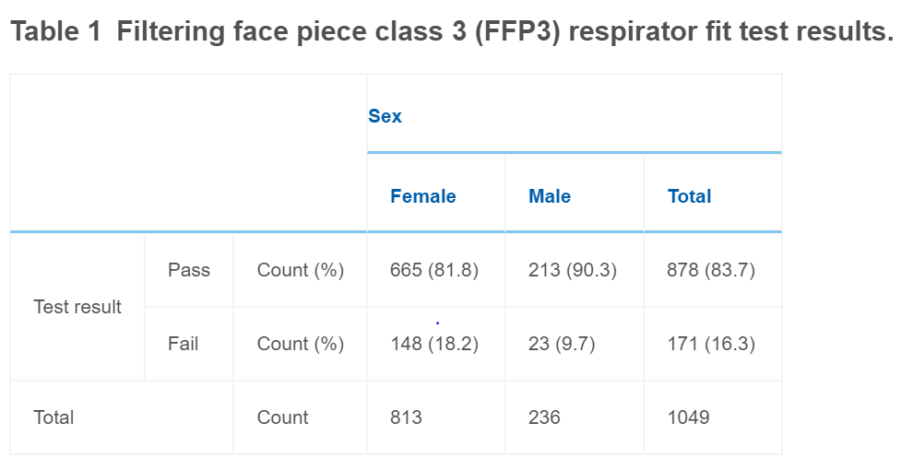
Disaggregating data
One size ‘fits all’ PPE:
Total fail rate: 16.3%
Female use fail rate: 18.2%
Male use fail rate: 9.7%
Disaggregating our data tells a more equitable story.

Slide 4
Ethical challenges
with disaggregated data
first consider whether it is necessary for the particular findings of your data set:
what are you trying to achieve?
Is it possible without data disaggregation?
if is also essential ensure that disaggregated data is used for ethically sound reasons, and not to further marginalise a subset of society

Slide 5
Approaches to these challenges
Define appropriate standards
Build the algorithm with a training set that is representative of the population being analysed
Create a set of benchmark criteria
Explain how an audit should check from data bias
Audit and improve based on outcomes

Slide 6
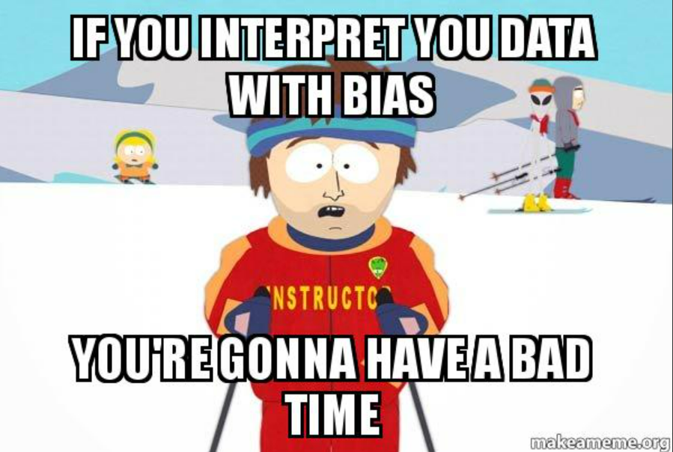
Conclusion

